Slide 1

Influence of TV commercials on web traffic - analysis
Paweł Pietrzak

Slide 2
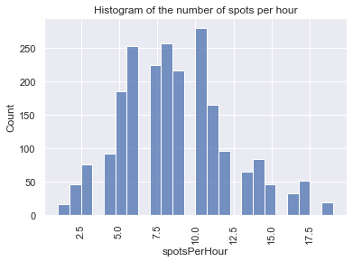
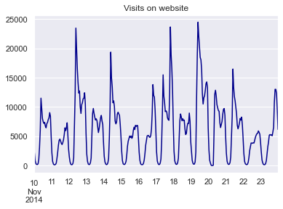
Background
The purpose of this exercise is to estimate the influence of the broadcasted advertising spots on the interest in a website.
Analysis covers the period from 10 to 23 November 2014.
Predictive modeling techniques were used to achieve the intended goals.
Analysis will answer the questions whether the TV spots affect the traffic on the website, if so, how and when…

Slide 3
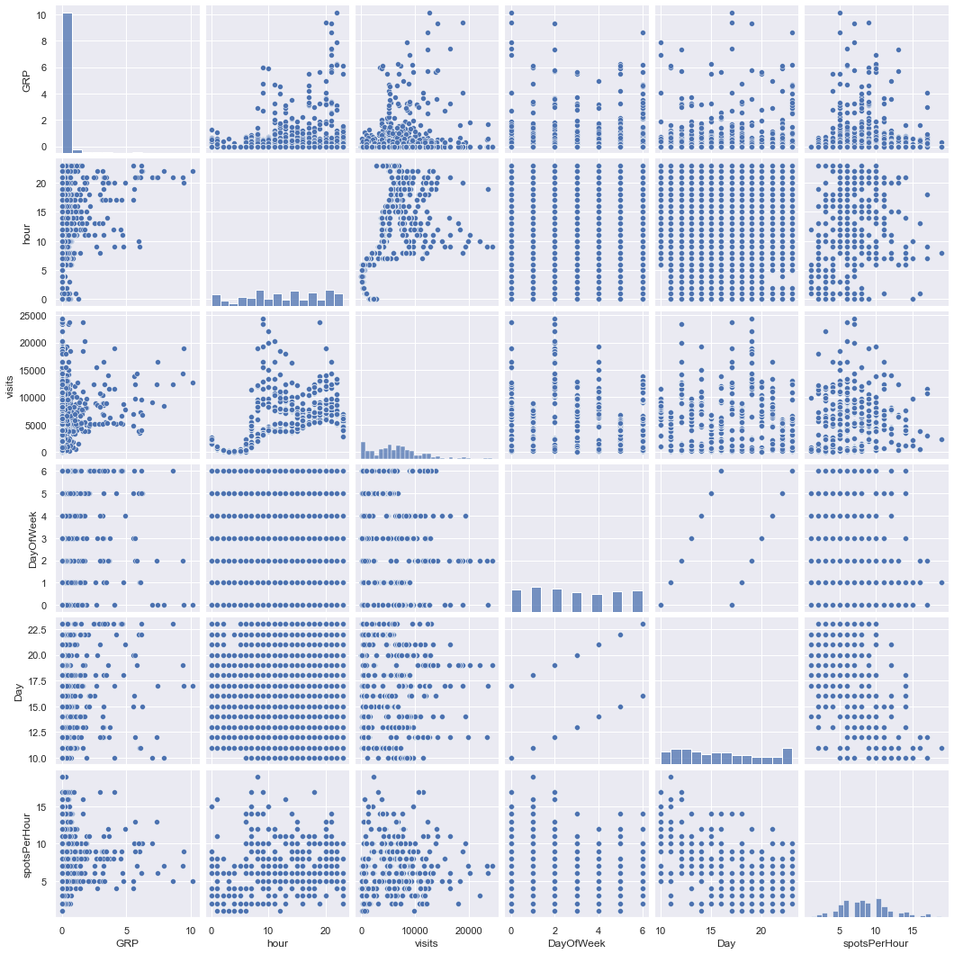
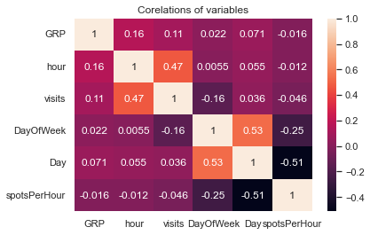
Data Preprocessing & Modeling
Data used for modeling were divided into two data sets (visits, spots).
First, data cleaning was performed. Especially the columns containing information about the broadcasting time of the spots needed improvement.
Based on the provided data, new columns were prepared, such as, for example, the day of the week and the number of visits to the website for a given hour.
The next step was to merge both datasets, variables selection for the model, categorical variables transformation and split of data into training and test sets.
After data preprocessing, the selection of the appropriate machine learning technique was started.
Models such as Linear Regression, Lasso Regularization, KNN, Random Forest, Gradient boosting and Decision tree were prepared and evaluated.

Slide 4
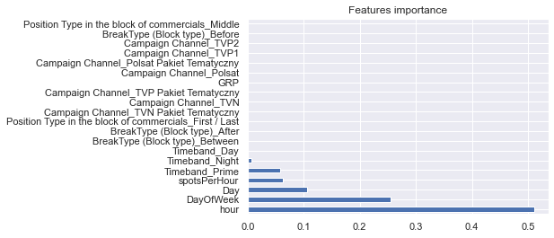
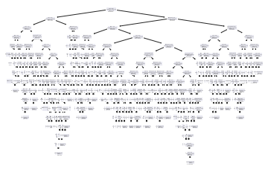
Selected model – Decission tree
Decision tree model was chosen as the most appropriate one.
This model consists of 330 leaves and its depth is equal to 17.
Even if the R2 coefficient for this model is 0.99 and the mean absoulte error is equal to 5 this model does not have a real high predictive power.
Probably due to the structure of the input data used, this model is not the best possible. On the other hand, it indicates reasonable conclusions.
Variables such as the time of broadcasting the spot, the day of the week and the intensity of the number of spots per hour have the greatest impact on the explained variable, i.e. the number of visits to the website.

Slide 5
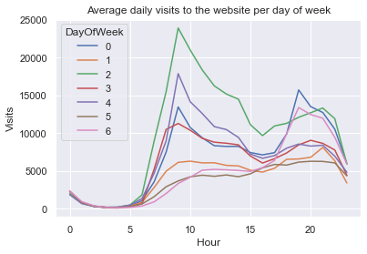
Conclusions
The purpose of this exercise was to estimate the influence of the broadcasted advertising spots on the interest in a website.
Model of the decision tree showed that the broadcasted TV spots have a significant impact on visits to the website.
The time of broadcasting the spot has the greatest impact on the number of visits. The tree structure indicates that the spots emitted after 7 o'clock have the greatest impact on the response variable.
In the chart on the right you can see that around 7 o'clock is the biggest peek of visits to the site.
The model also showed that the frequency of spots significantly influences website visits.

